Slide 1
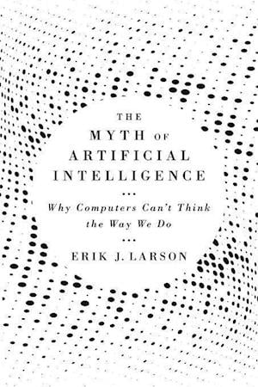
The Myth of AI
COMP 4230
David J Stucki
Fall 2024

Slide 2
Alerts
Assignment 2 is due today
Use the weekend to catch up on any reading you haven't completed.

Slide 3
Discussion Groups
Group 1: Dylan, David, Sam, Ashley, Isaac
Group 2: Kyle H., Nick, Joel, Max, Jacob L.
Group 3: Kyle M., Abe, Jacob R., Cameron, Alan
Larson Chapter 3 (15 minutes)
Larson Chapter 4 (10 minutes)
Larson Chapter 5 (5 minutes)
Larson Chapter 6 (10 minutes)

Slide 4
Next Time…
Neural Networks

